Slide 1
Hoạt động của CNN: Convolutional Neural Networks

Slide 2
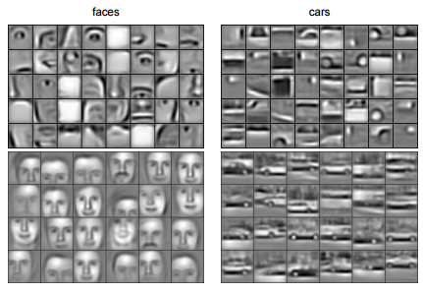
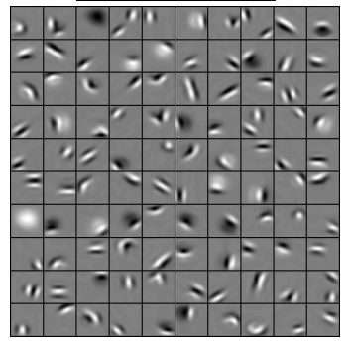
Convolutional Deep Belief Networks for Scalable Unsupervised Learning of Hierarchical Representations Honglak Lee, Roger Grosse, Rajesh Ranganath, Andrew Y. Ng

Slide 3
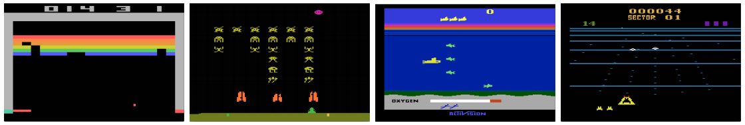
Playing Atari with Deep Reinforcement Learning. Volodymyr Mnih, Koray Kavukcuoglu, David Silver, Alex Graves, Ioannis Antonoglou, Daan Wierstra, Martin Riedmiller

Slide 4
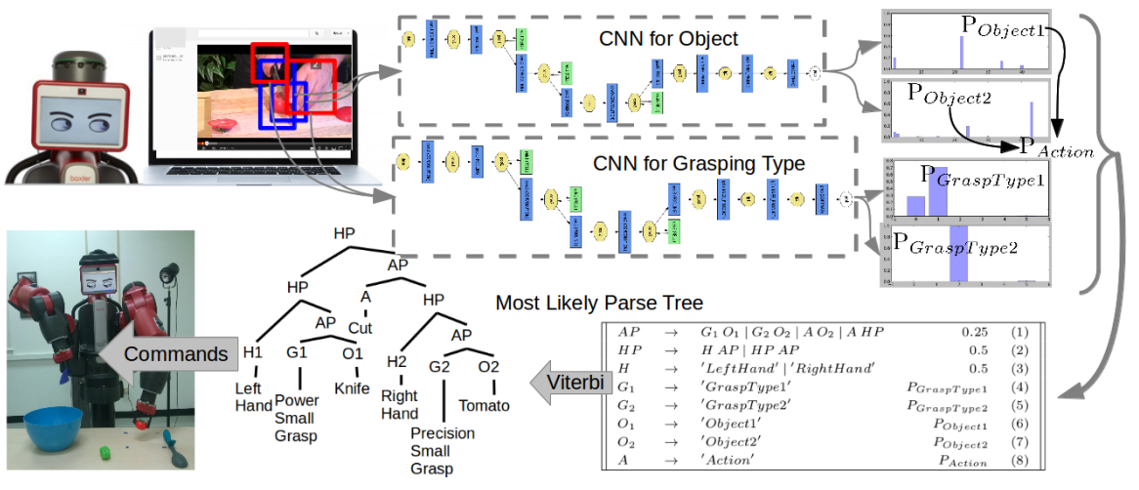
Robot Learning ManipulationAction Plans by “Watching” Unconstrained Videos from the World Wide Web. Yezhou Yang, Cornelia Fermuller, Yiannis Aloimonos

Slide 5
A toy ConvNet: X’s and O’s
A two-dimensional
array of pixels
CNN
X or O
Says whether a picture is of an X or an O

Slide 6
For example
CNN
X
CNN
O

Slide 7
Trickier cases
CNN
X
translation
scaling
rotation
weight
CNN
O

Slide 8
Deciding is hard
?
=

Slide 9
What computers see
?
=

Slide 10
What computers see

Slide 11
Computers are literal
=
x

Slide 12
ConvNets match pieces of the image
=
=
=

Slide 13
Features match pieces of the image

Slide 19
Filtering: The math behind the match

Slide 20


Slide 21
Filtering: The math behind the match
Line up the feature and the image patch.
Multiply each image pixel by the corresponding feature pixel.
Add them up.
Divide by the total number of pixels in the feature.

Slide 22
Filtering: The math behind the match
1 x 1 = 1

Slide 23
Filtering: The math behind the match
1 x 1 = 1

Slide 24
Filtering: The math behind the match
-1 x -1 = 1

Slide 25
Filtering: The math behind the match
-1 x -1 = 1

Slide 26
Filtering: The math behind the match
-1 x -1 = 1

Slide 27
Filtering: The math behind the match
1 x 1 = 1

Slide 28
Filtering: The math behind the match
-1 x -1 = 1

Slide 29
Filtering: The math behind the match
-1 x -1 = 1

Slide 30
Filtering: The math behind the match
-1 x -1 = 1

Slide 31
Filtering: The math behind the match
1 x 1 = 1

Slide 32

Filtering: The math behind the match
$$\frac{1+1+1+1+1+1+1+1+1}{9}=1$$

Slide 33
Filtering: The math behind the match
1 x 1 = 1

Slide 34
Filtering: The math behind the match
-1 x 1 = -1

Slide 35
Filtering: The math behind the match

Slide 36

Filtering: The math behind the match
$$\frac{1+1−1+1+1+1−1+1+1}{9}=.55$$
.55

Slide 37
Convolution: Trying every possible match

Slide 38
Convolution: Trying every possible match
=

Slide 39
=
=
=

Slide 40
Convolution layer
One image becomes a stack of filtered images

Slide 41
Convolution layer
One image becomes a stack of filtered images

Slide 42
Pooling: Shrinking the image stack
Pick a window size (usually 2 or 3).
Pick a stride (usually 2).
Walk your window across your filtered images.
From each window, take the maximum value.

Slide 43
Pooling
maximum

Slide 44
Pooling
maximum

Slide 45
Pooling
maximum

Slide 46
Pooling
maximum

Slide 47
Pooling
maximum

Slide 48
Pooling
max pooling

Slide 50
Pooling layer
A stack of images becomes a stack of smaller images.

Slide 51
Normalization
Keep the math from breaking by tweaking each of the values just a bit.
Change everything negative to zero.

Slide 52
Rectified Linear Units (ReLUs)

Slide 53
Rectified Linear Units (ReLUs)

Slide 54
Rectified Linear Units (ReLUs)

Slide 55
Rectified Linear Units (ReLUs)

Slide 56
ReLU layer
A stack of images becomes a stack of images with no negative values.

Slide 57
Layers get stacked
Convolution
ReLU
Pooling
The output of one becomes the input of the next.

Slide 58
Deep stacking
Convolution
ReLU
Convolution
ReLU
Pooling
Convolution
ReLU
Pooling
Layers can be repeated several (or many) times.

Slide 59
Fully connected layer
Every value gets a vote

Slide 60
Fully connected layer
X
Vote depends on how strongly a value predicts X or O
O

Slide 61
Fully connected layer
X
Vote depends on how strongly a value predicts X or O
O

Slide 62
Fully connected layer
X
Future values vote on X or O
O

Slide 63
Fully connected layer
X
Future values vote on X or O
O

Slide 64
Fully connected layer
X
.92
Future values vote on X or O
O

Slide 65
Fully connected layer
X
.92
Future values vote on X or O
O

Slide 66
Fully connected layer
X
.92
Future values vote on X or O
O
.51

Slide 67
Fully connected layer
X
.92
Future values vote on X or O
O
.51

Slide 68
Fully connected layer
X
A list of feature values becomes a list of votes.
O

Slide 69
Fully connected layer
X
These can also be stacked.
O

Slide 70
Putting it all together
.92
X
Convolution
ReLU
Fully
connected
Fully
connected
Convolution
ReLU
Convolution
ReLU
Pooling
Pooling
A set of pixels becomes a set of votes.
O
.51

Slide 71
Learning
Q: Where do all the magic numbers come from?
Features in convolutional layers
Voting weights in fully connected layers
A: Backpropagation

Slide 72
Backprop
.92
X
Convolution
ReLU
Fully
connected
Fully
connected
Convolution
ReLU
Convolution
ReLU
Pooling
Pooling
Error = right answer – actual answer
O
.51

Slide 73
Backprop
.92
X
Convolution
ReLU
Fully
connected
Fully
connected
Convolution
ReLU
Convolution
ReLU
Pooling
Pooling
O
.51

Slide 74
Backprop
.92
X
Convolution
ReLU
Fully
connected
Fully
connected
Convolution
ReLU
Convolution
ReLU
Pooling
Pooling
O
.51

Slide 75
Backprop
.92
X
Convolution
ReLU
Fully
connected
Fully
connected
Convolution
ReLU
Convolution
ReLU
Pooling
Pooling
O
.51

Slide 76
Backprop
.92
X
Convolution
ReLU
Fully
connected
Fully
connected
Convolution
ReLU
Convolution
ReLU
Pooling
Pooling
O
.51

Slide 77
Backprop
.92
X
Convolution
ReLU
Fully
connected
Fully
connected
Convolution
ReLU
Convolution
ReLU
Pooling
Pooling
O
.51

Slide 78
Gradient descent
error
For each feature pixel and voting weight, adjust it up and down a bit and see how the error changes.
weight

Slide 79
Gradient descent
error
For each feature pixel and voting weight, adjust it up and down a bit and see how the error changes.
weight

Slide 80
Hyperparameters (knobs)
Convolution
Number of features
Size of features
Pooling
Window size
Window stride
Fully Connected
Number of neurons

Slide 81
Architecture
How many of each type of layer?
In what order?

Slide 82
Not just images
Any 2D (or 3D) data.
Things closer together are more closely related than things far away.

Slide 83
Images
Columns of pixels
Rows of pixels

Slide 84
Sound
Time steps
Intensity in each
frequency band

Slide 85
Text
Position in
sentence
Words in
dictionary

Slide 86
Limitations
ConvNets only capture local “spatial” patterns in data.
If the data can’t be made to look like an image, ConvNets are less useful.

Slide 87
Customer data
Name, age,
address, email,
purchases,
browsing activity,…
Customers

Slide 88
Rule of thumb
If your data is just as useful after swapping any of your columns with each other, then you can’t use Convolutional Neural Networks.

Slide 89
In a nutshell
ConvNets are great at finding patterns and using them to classify images.

Slide 90
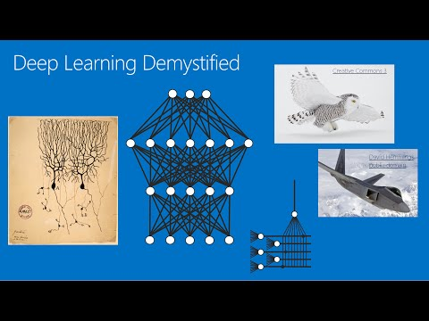
Also check out
Deep Learning Demystified
Notes from Stanford CS 231 course
(Justin Johnson and Andrej Karpathy)
The writings of Christopher Olah

Slide 91
Some ConvNet/DNN toolkits
Caffe (Berkeley Vision and Learning Center)
CNTK (Microsoft)
Deeplearning4j (Skymind)
TensorFlow (Google)
Theano (University of Montreal + broad community)
Torch (Ronan Collobert)
Many others

Slide 92
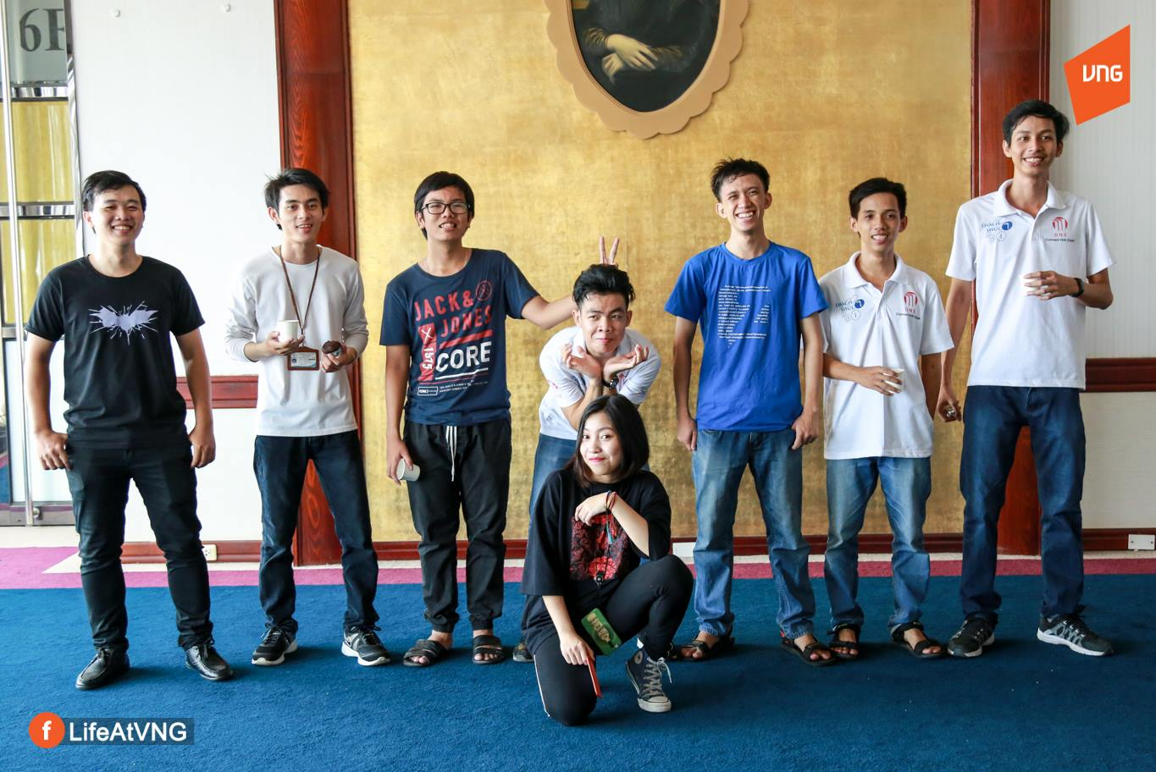

THANK YOU FOR LISTENING!
________________________________
Email:1512005@student.hcmus.edu.vn
Facebook:fb.com/tianangthang7
Email: bienhuynh96@gmail.com
Facebook:fb.com/tianangthang7
____________________________________

